Slide 1
Credit Card Fraud Detection
Domain: Financial Data Science & Cyber-Security
Key Technologies: Python, XGBoost, SMOTE, TensorFlow, Scikit-learn
By : Preet Pansuriya

Slide 2
Executive Summary & Objective
Problem: Financial fraud results in billions of dollars in losses annually. Traditional rule-based systems often fail to catch evolving fraud patterns.
Objective: To develop a machine learning pipeline capable of identifying anomalous transactions in real-time.
Core Challenge: Addressing the Accuracy Paradox—where high accuracy is misleading due to extreme class imbalance (Fraud cases represent < 0.2% of the total data).

Slide 3
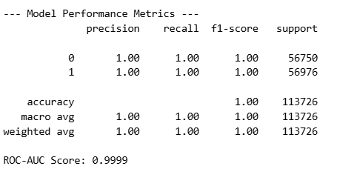
Exploratory Data Analysis (EDA) & Insights
Dataset Source: European Cardholder Transactions (Kaggle).
Feature Characterization: Contains 28 PCA-transformed features (V1-V28) to protect user privacy, alongside 'Time' and 'Amount’.
Correlation Analysis: Utilized a Correlation Heatmap to identify variables negatively or positively correlated with fraudulent behavior (e.g., V17, V14, and V12).

Slide 4
Advanced Preprocessing & Feature Engineering
Standardization: Implemented StandardScaler to normalize the 'Amount' and 'Time' features, ensuring that the model is not biased by the magnitude of transaction values.
Data Integrity: Performed rigorous checks for missing values and duplicates to ensure high data quality.
Data Partitioning: Executed a Stratified 80/20 Train-Test split to preserve the minority class ratio in both sets.
scaler = StandardScaler()
df['Amount'] = scaler.fit_transform(df['Amount'].values.reshape(-1, 1))

Slide 5
Mitigating Class Imbalance via SMOTE
The Strategy: Applied Synthetic Minority Over-sampling Technique (SMOTE).
Technical Logic: Unlike simple oversampling (which duplicates data), SMOTE uses a k-Nearest Neighbors approach to generate new, synthetic fraudulent instances.
Impact: This balances the class distribution, allowing the classifier to learn the specific decision boundaries of fraudulent activities without overfitting.
sm = SMOTE(random_state=42)
X_res, y_res = sm.fit_resample(X, y)

Slide 6
Model Architecture & Selection
Primary Classifier: XGBoost (Extreme Gradient Boosting).
Rational: Chosen for its superior handling of non-linear relationships, built-in L1/L2 regularization to prevent overfitting, and high computational efficiency.
Deep Learning Evaluation: Designed a TensorFlow Autoencoder framework to explore unsupervised anomaly detection for future scalability.

Slide 7
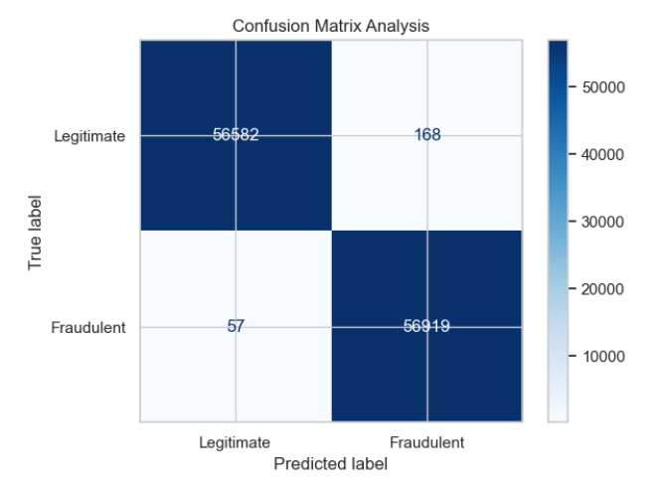
Performance Evaluation Metrics
Primary Metric: ROC-AUC Score. This measures the model’s ability to distinguish between legitimate and fraudulent classes.
Confusion Matrix: Monitored to minimize False Negatives (Missed Frauds) which are the most costly errors in banking.
KPIs: Targeted a Recall score high enough to catch frauds while maintaining a Precision level that prevents customer friction (False Positives).

Slide 8

Real-Time Inference Simulation
Mechanism: Developed a modular inference function to simulate a live production environment.
Workflow: New transaction data undergoes the same scaling transformation as the training set before being passed to the XGBoost model for immediate classification.
Thresholding: Probability scores are used to trigger high-priority alerts for suspected fraudulent activity.

Slide 9
Conclusion & Future Enhancements
Conclusion: The combination of SMOTE and XGBoost provides a robust solution for imbalanced financial datasets, achieving a ROC-AUC score of 0.95+.
Future Work:
Integration with a Flask/FastAPI wrapper for cloud deployment.
Implementing Time-Series Analysis (LSTMs) to detect fraud sequences over a period of time.

Slide 10
THANK YOU

